Slide 1
Letters to Santa
Badger Autumn 2

Slide 2


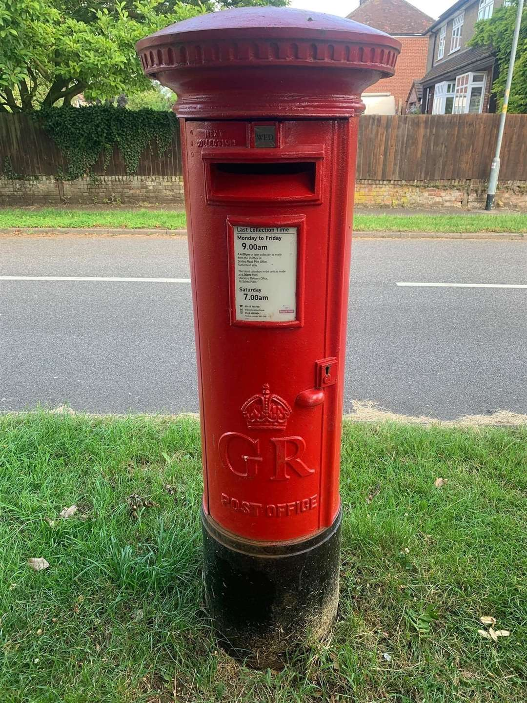
Literacy
In Literacy, we will be reading ‘The Jolly Christmas Postman’.
We will look at some of the basic features of letters before thinking about what we might like to ask Santa for Christmas. With scaffolding and support, children will create their own letters for Santa which they will send off to the North Pole on a little walk to the local post box.
Some children will have a go at typing their work using a computer or iPad whilst others will be supported by an adult to record their ideas such as through scribing or use of symbols.

Slide 3
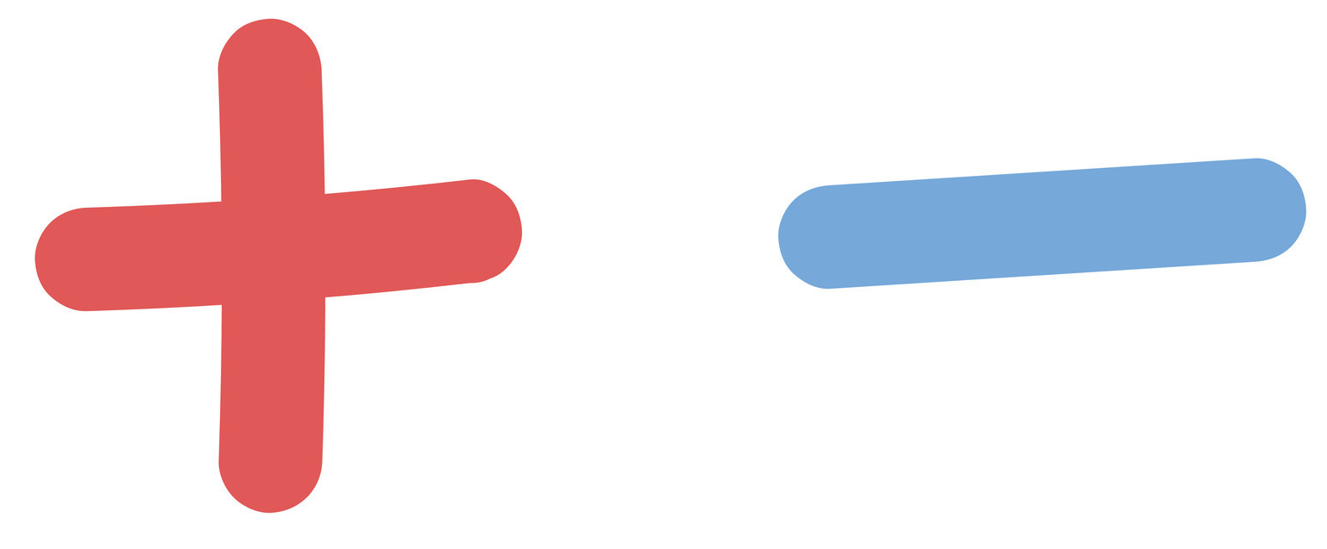
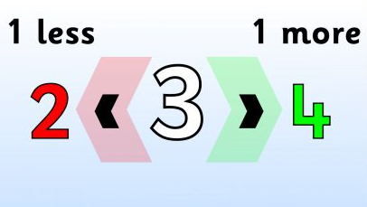
Maths
In maths, some children will be beginning to work on addition and subtraction. This will begin with children adding 2 1-digit numbers to make totals to 10. They will then have a go at subtracting 1 digit numbers from 10 to identify the amount that remains. Children will do this first using objects to represent the amounts before working with pictorials. Once they have built their confidence with this, they will then work on completing number sentences focusing on adding and subtracting within 10.
Other children will be working on identifying 1 more and 1 less than a number. They will begin doing this using physical objects before building up to use pictorials and eventually numerals.

Slide 4
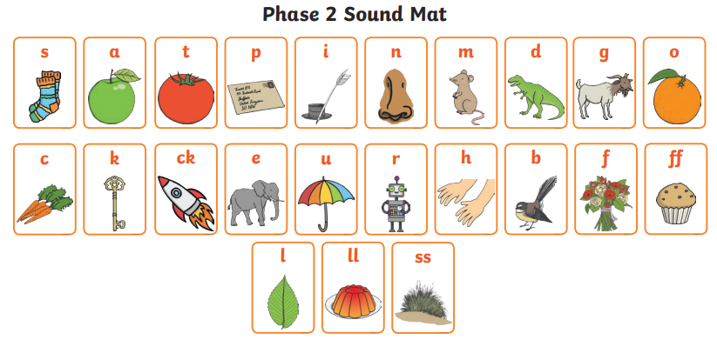
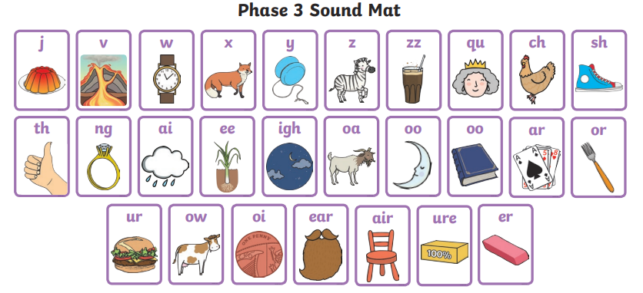

Phonics
In phonics, children will work in small groups supported by an adult focusing on practising and learning sounds according to which phase they are working at. Children will continue practising to blend to read and segment to spell words as well as sort objects according to the sounds that they contain.

Slide 5
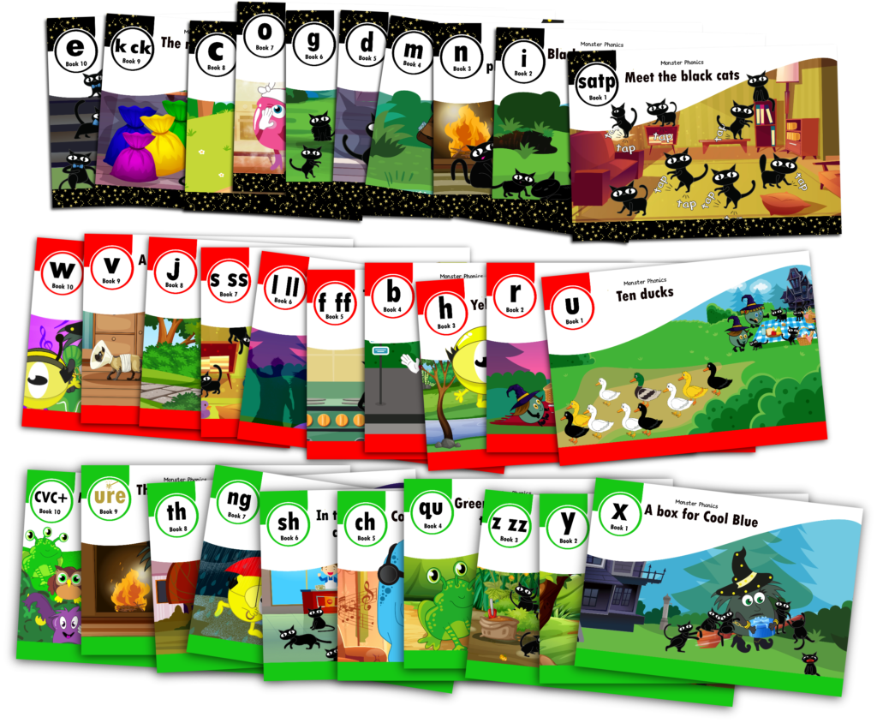
Reading
Children will also have a Monster Phonics book which is a decodable text which will contain words with sounds that they have been working on. They will read these with an adult in school up to 3 times a week. They will also be able to take these home to read. We will also visit the school library every Wednesday where children will be able to choose a book to take away with them. Please ensure that library books are returned to school on Wednesday for children to be able to change their book.

Slide 6
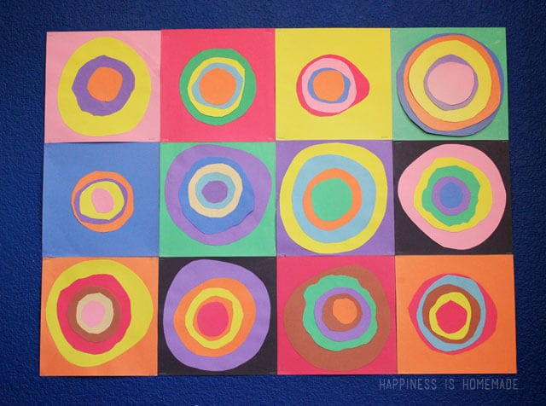
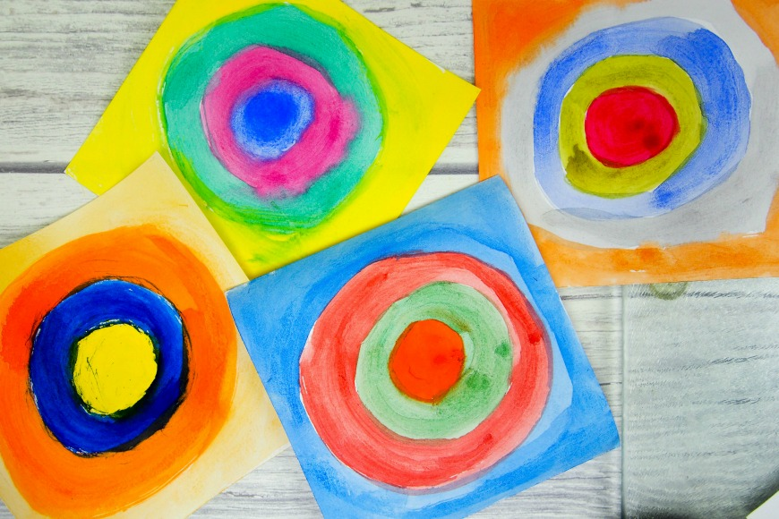
Art
In art, we will be exploring some work of the artist Kandinsky, with a particular focus on his concentric circles art work. Children will firstly identify the primary colours before exploring colouring mixing to create secondary ones. We will then have a go at painting our own concentric circles inspired by Kandinsky using a variety of the colours created. We will also then make Christmas tree ornaments inspired by this artwork by shaping clay before painting on the circle shapes.

Slide 7
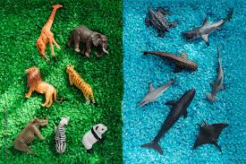
Science
In Science, we will be exploring different animals and having a go at labelling their body parts. We will then have a go at sorting animals into groups according to given categories such as whether they can fly or not and if they live in water or on land.

Slide 8

Geography
In Geography, we will first explore how we celebrate Christmas such as what food many people eat on Christmas Day.
We will then have a look at how people in different countries celebrate Christmas to identify similarities and differences.

Slide 9
PE and Physio
In PE, we will be having a go at a variety of activities focusing on building children’s ability and confidence to travel around a space in different ways as well as changing direction. They will also have opportunities to spend some time in the soft play and engage in team building activities such as playing parachute games.
Children with physio programmes will continue to be supported to complete set exercises. They will have 2 sessions a week to work on these specific exercises.
Children with specialist equipment such as standing and walking frames will also use these at various times during the week. Most children will stand in their standing frame daily.

Slide 10
PSHE
In PSHE, children will be split into groups. The reason for this being that some topics are currently more relevant to some children then they are to others.
Some children will be exploring what, when and with who they should share their personal information with. We will also touch on some internet safety in relation to this.
Other children will be working on building their self esteem within their learning to help encourage them to recognise that there are some things that we are not going to be able to do straight away and that is ok. They will also touch on how they can help to boost the self esteem of others through their actions and/or words.

Slide 11
RE
Our RE this half term, we will be centred around ‘gifts’. We will think about gifts that we have received in the past and which we might like to receive for Christmas this year. We will consider how giving and receiving gifts make us feel.
As part of this, we will also explore what gifts the Three Wisemen gave Jesus and consider what gifts Jesus might have been gifted if he had been born today.

Slide 12
Enrichment
We will continue to have additional sessions delivered by specialists including:
Relax Kids with Kath on Tuesday
Forest School with Emily on Tuesday
Music with Kathleen on Thursday
Move Momentum with Daisy on Friday
We will also enjoy some Christmas activities towards the end of the half term. In the meantime, we will be practising some songs for our Christmas performance which we hope you will be able to join us for!

