Slide 1


The Lion, the witch and the wardrobe
Spring 1

Slide 2
Literacy
In Literacy, we will be reading ‘The Lion, the Witch and the Wardrobe’ from the ‘Chronicles of Narnia’ series. We will be working to describe the character ‘Mr Tumnus’ as well as Lucy’s first sight of Narnia with the aim of creating a short diary entry from her perspective. As part of this, children will be having a go at creating expanded noun phrases as well as using conjunctions in their writing. Children will record their work in a variety of ways in accordance to what is best for them.

Slide 3
Maths
In Maths, we will be focusing on money, first recapping our knowledge of coins and notes. After, children will explore making given amounts using different coins, seeing what different combinations they can use and having a go at using the smallest number of coins. Children will also be able to practice and consolidate counting in 2s, 5s and 10s when using the corresponding coins.

Slide 4

Phonics
In phonics, children will be continuing to learn new graphemes according to where they are with their learning of these currently. As part of this, children will be working to build their confidence blending to read words as well as segmenting to spell them.
They will continue to learn new HFWs (High Frequency Words) by using their knowledge from previous graphemes taught, and by recognising them through sight.
Children will be given a decodable book which they will read to an adult at various times during the week. During reading, adults will ask children questions to help develop their comprehension skills.

Slide 5
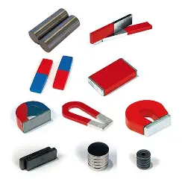
Science
In Science, we will be working on the topic of ‘forces and magnets’. We will learn about what magnets are and how they work, incorporating previous knowledge of push and pull forces. We will carry out simple tests to identify and sort items according to whether they are magnetic or not. Later, children will be support to plan a fair test to compare magnets to see if different types of magnets are more powerful than another.

Slide 6
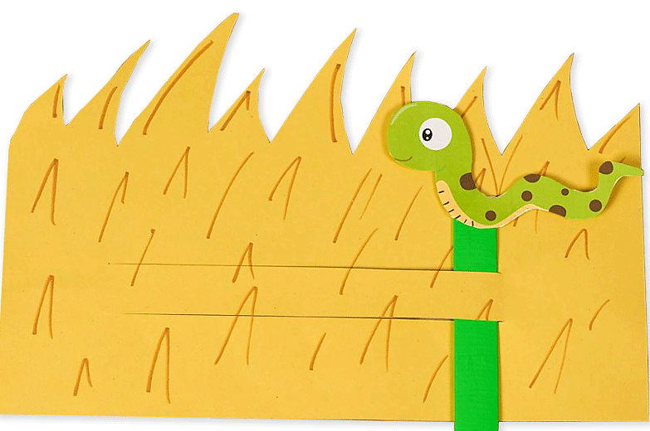
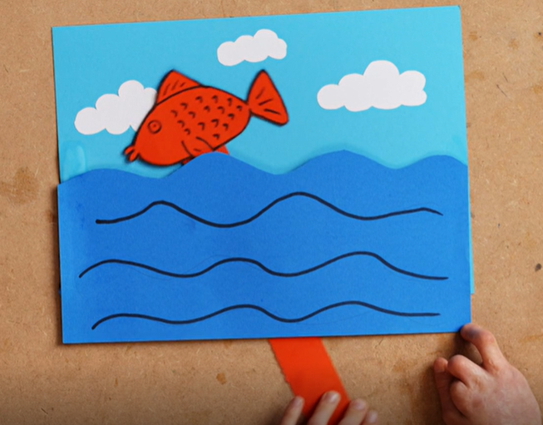
DT
In DT, we will be exploring ways in which we can make pictures move. As part of this, children will explore some existing products as well as different ways to move pictures such as levers, sliders and wheels. Later, they will create a moving picture inspired by ‘The Lion, the witch and the wardrobe’. Children will be encouraged to plan their ideas and evaluate them by considering what went well and if there is anything they could do better next time.

Slide 7
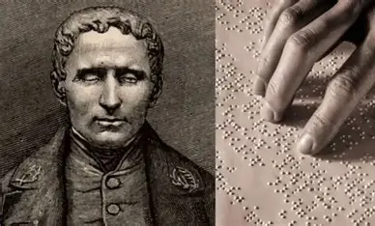
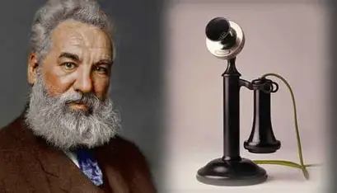
History
In History, we will be learning about inventors. We will explore what they invented, as well as how their inventions helped and continue to help people. Inventors we will learn about include:
Louis Braille Alexander Graham Bell
Inventor of Braille
Inventor of the telephone

Slide 8
RE
In RE, we are exploring the theme of storytelling. First, thinking about what stories are and what some of our favourites are. We will also consider what a storyteller is and why they are important. After, we will learn about key texts in Islam and look at some stories from the religion which often have a moral.

Slide 9
PSHE
In PSHE, we will be thinking about what a trusted adult is and who are some of the adults that we trust. As part of this, we will touch on what a stranger is and how we can be safe around them. We will also touch on what and who ‘safer strangers’ are such as police, doctors and nurses.
Linking with our topic in maths, we will also do some PSHE focusing on money. First exploring what we use money for and how it is obtained.

Slide 10
PE
In PE, we are doing a unit of dance inspired by ‘The Lion, the witch and the wardrobe’. Children will be working together to tell the story of Lucy’s discovery of Narnia through a sequence of created actions. As part of this, children will be encouraged to ensure that they are moving safely through the space, making sure to not bump into anyway by changing their direction or speed.
Children with physio programmes and additional equipment such as walkers will continue to be supported to engage with these.

Slide 11


Enrichment
We will continue to have additional sessions delivered by specialists including:
Forest School with Emily on Tuesday
Please send your child to school with suitable clothing and shoes for these sessions as they are spent outside.
Relax Kids with Kath on Thursday
Music with Kathleen on Thursday
Move Momentum with Daisy on Friday

