Slide 1
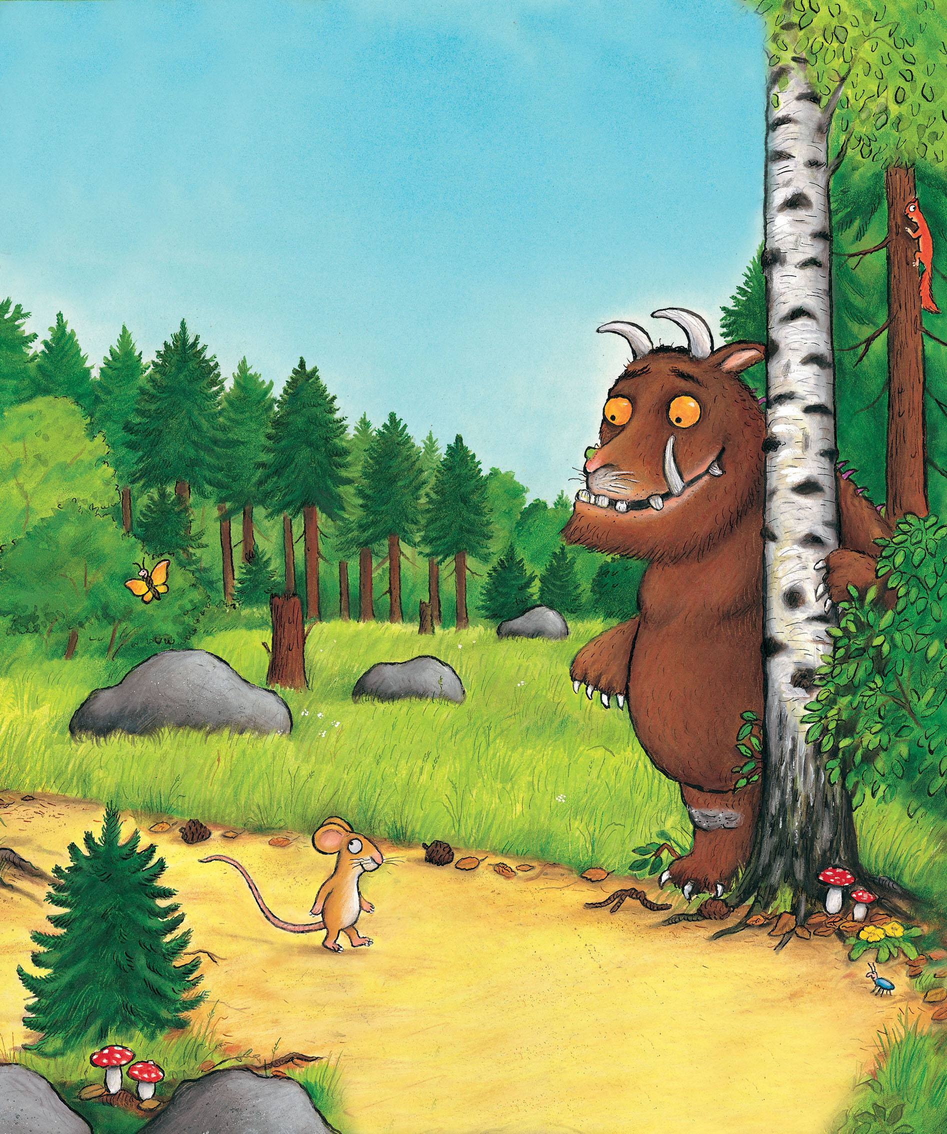
Squirrel Class
Rich Text
Spring Term I 2025

Slide 2
This half term we will be exploring the following stories and will build our learning on:
The Gruffalo
The Gruffalo’s child
The smartest giant in town.

Slide 3
Personal, social and emotional development
Our new topic and stories will allow us in Squirrel Class to explore and become more aware of some new emotions via the story characters feelings. In The Gruffalo we will be able to observe and explore being scared as the anticipation builds up to see/meet the Gruffalo and the Big Bad Mouse in The Gruffalo’s Child. We will also be looking at how the clever mouse was feeling after how it out-smarted all his forest friends. In the smartest giant in town story we will be focusing on being kind and feeling happy and warm after a kind act.

Slide 4
Communication and language
We will continue to work on the recognition of visual and or auditory clues to support the children’s anticipation and understanding of the daily routine, the story line and even personal care activities.
We will also continue to use total communication in class throughout the day to give equal opportunity to enable children to make connection between spoken, alternative and augmentative communication systems.
The class will continue to use visual timetable and ‘Now’ and ‘Next’ board to support the children’s transitions between the different activities.
Children will be placed into groups for Monster Phonics and early phonics groups where they can be further supported to work towards their communication and language targets.
.

Slide 5
Physical development
The children will be continuing to complete their physio exercises on a regular basis with sufficient support. During PE lessons we will be practicing some story character skills such as stomping like a Gruffalo, stretch and roll like a snake, opening arms wide and pretend to be flying like an owl, and standing tall like a giant. The children will be encouraged to manipulate more with their hands and making strong fists like the big bad mouse or opening their hands to make handprints for ‘marks in the snow’. We will be also practicing putting on and pulling off soft scarves off our heads/upper bodies to support dressing and undressing, just like the giant did.

Slide 6
Maths
This half term in maths we will be focusing on quantities, sizes, 1:1 correspondence and positional language. The children will be exploring and manipulating with topic related sensory activities using natural resources (twigs, pine cones, ice), building blocks, story characters, clothing items and other soft fabrics. We will be going on topic related scavenger hunts to further widen the children’s learning opportunities.
We will also continue to strengthen the children’s number knowledge via rhymes, songs, and other topic related maths activities.

Slide 7
Literacy
In literacy the children will be introduced to our three main stories as the term goes on. We will start our learning activities built around The Gruffalo, then The Gruffalo’s child and will finish with The smartest giant in town. The children will have opportunities to access a sensory version of the stories to further increase their interest, listening and understanding while other groups of children will be completing story sequencing.
The children will be manipulating with play dough as we will make story characters and they will have the opportunity to make some Gruffalo krispies a spart of their early mark making skills (grasping/releasing tools and media.

Slide 8
Understanding the world
We will continue to introduce some traditions and celebrations this half term. The children will have the opportunity to experience dragon dance in school as part of the Chinese New Year celebration and we will celebrate Valentine’s Day in an age appropriate way.
The children will continue to have the opportunity to manipulate with technological resources such as switch operated toys to further develop their understanding of how things work via cause and effect activities.

Slide 9
Expressive art and design
The children will be given opportunities throughout the weeks to manipulate with different materials and textures during art activities. They will be creating different prints and effects by combining resources, e.g. paint and bubble wrap to create a snake print effect. In class we will be making no-bake cakes and cookies which the children will be able to decorate as they like.
The children will continue to have the opportunity to take part in Move Momentum, a sensory music session where the they are encouraged to respond to music via bodily movement. They also have the opportunity to explore different musical instruments during our weekly music lessons.

