Slide 1
This Half Term, our topic is based around farms and our focus book is ‘The Little Red Hen’
Spring 1

Slide 2
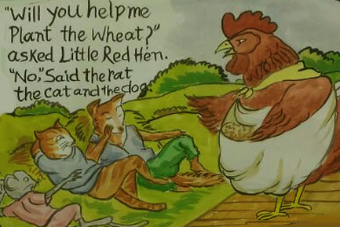
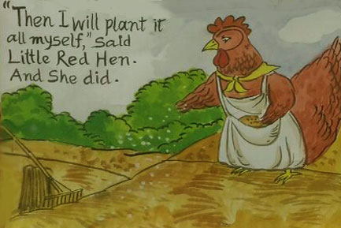
Literacy
In literacy, we will be reading the classic story of ‘The Little Red Hen’. We will identify what characters are in the story as well as where it is set. We will also work on sequencing what happens in the story to help us to retell it.
Some of us will also have a go at ordering relevant and familiar words given to them to make a simple sentence. Whilst others will have a go at composing their own simple sentences to retell parts of the story.

Slide 3
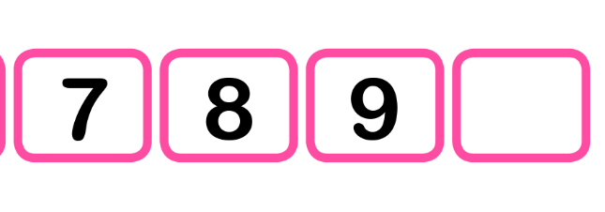
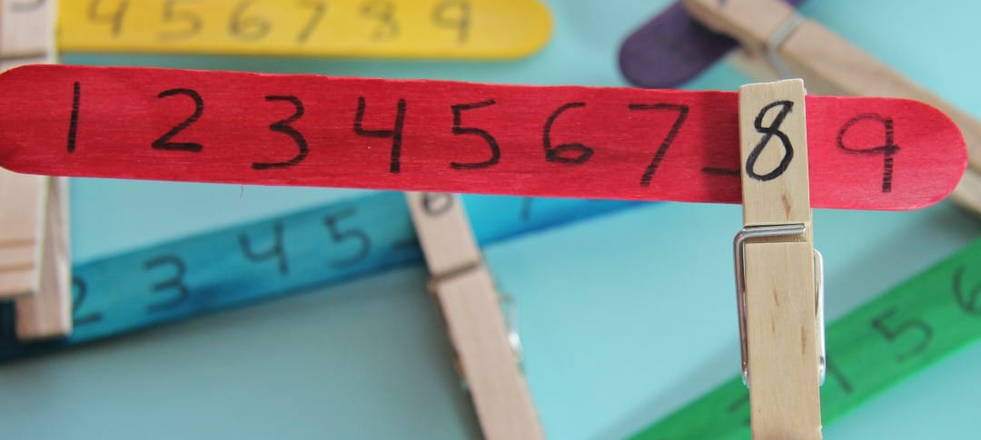
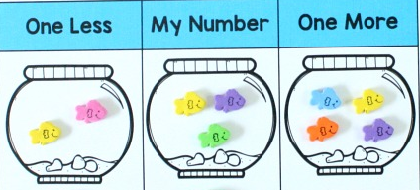
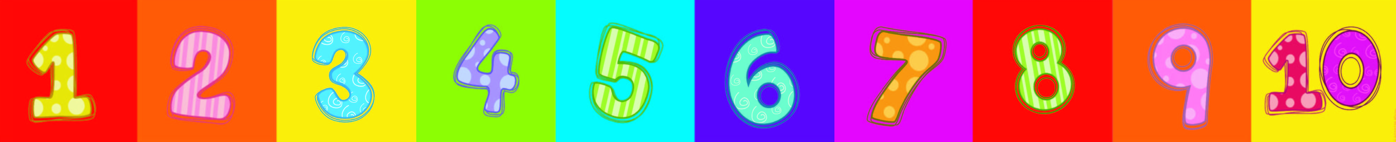
Maths
In maths, we will be working on identifying 1 more/1 less than a given number of objects or pictorials. Some of us may also have a go at identifying 2-3 more/less. Children will work on representing this increase or decrease by adding or removing an object/picture. Children will be working within a range of numbers appropriate to them.
We will also be working on using the language of ‘more, less, equal’ when comparing amounts. Some children will be introduced to number lines to support them to count on in order to identify how many more objects/pictorials there are compared to another set.
Children will continue their work with number lines to begin identifying a missing number in a sequence.

Slide 4
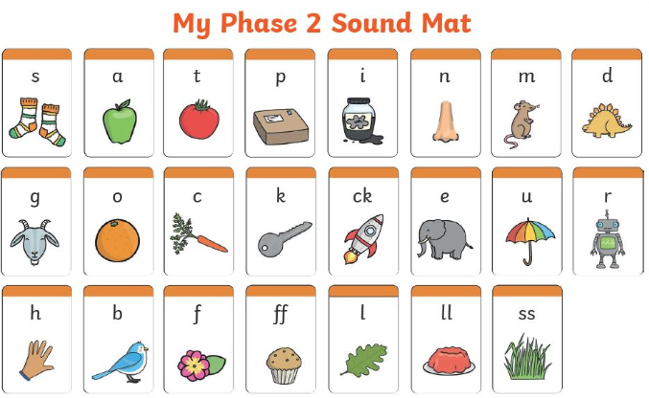
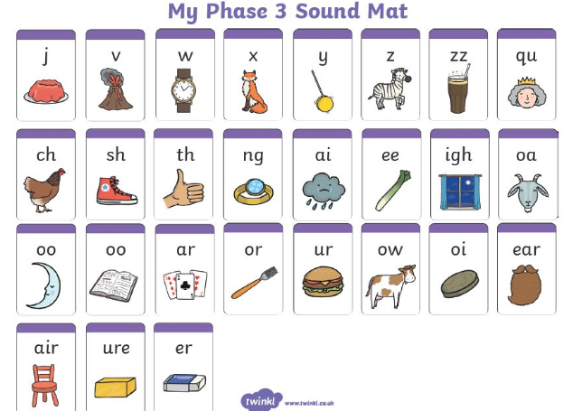
Phonics
Children work in small groups or 1:1 with an adult in phonics 4 times a week.
Over the next few weeks children will be working on building their recognition of different letter sounds, practising blending to read and segmenting to spell words containing sounds they are familiar with. Each group will be working on a different sound according to where they are working at. Some children will be working on Phase 2 sounds whilst others will be working on Phase 3 sounds.
Reading
Children also read 4 times a week in a small group or 1:1 with an adult. Some children will be working on reading decodable books whilst others will be listening to an adult reading to them. Through activities and questioning, children will also work on building comprehension skills.

Slide 5
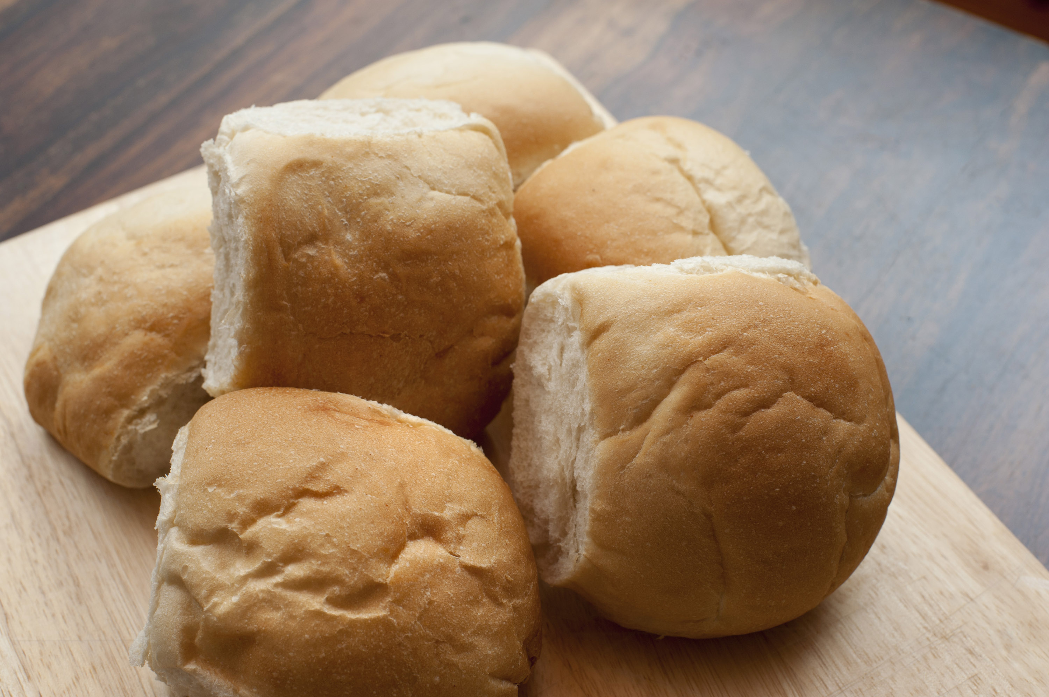
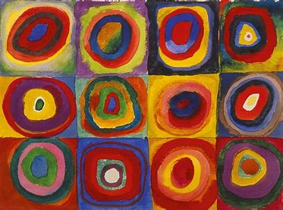
Art
In Art, we will be exploring the work of Wassily Kandinsky, in particular 'squares with concentric circles’.
As part of this, we will explore primary and secondary colours, as well as experimenting with creating different shades of the same colour. Then, children will have a go at creating their own versions of this piece of art work.
DT
Inspired by ‘The Little Red Hen’, we will be following a recipe to make bread rolls. As part of this, we will also consider food hygiene by making sure we wash our hands before touching any of the ingredients as well as cleaning the surfaces that we are working on.

Slide 6
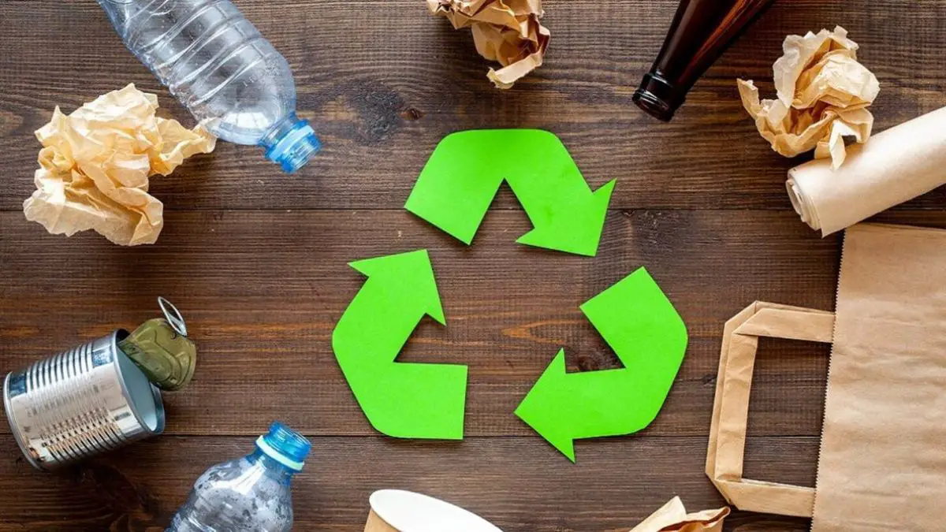
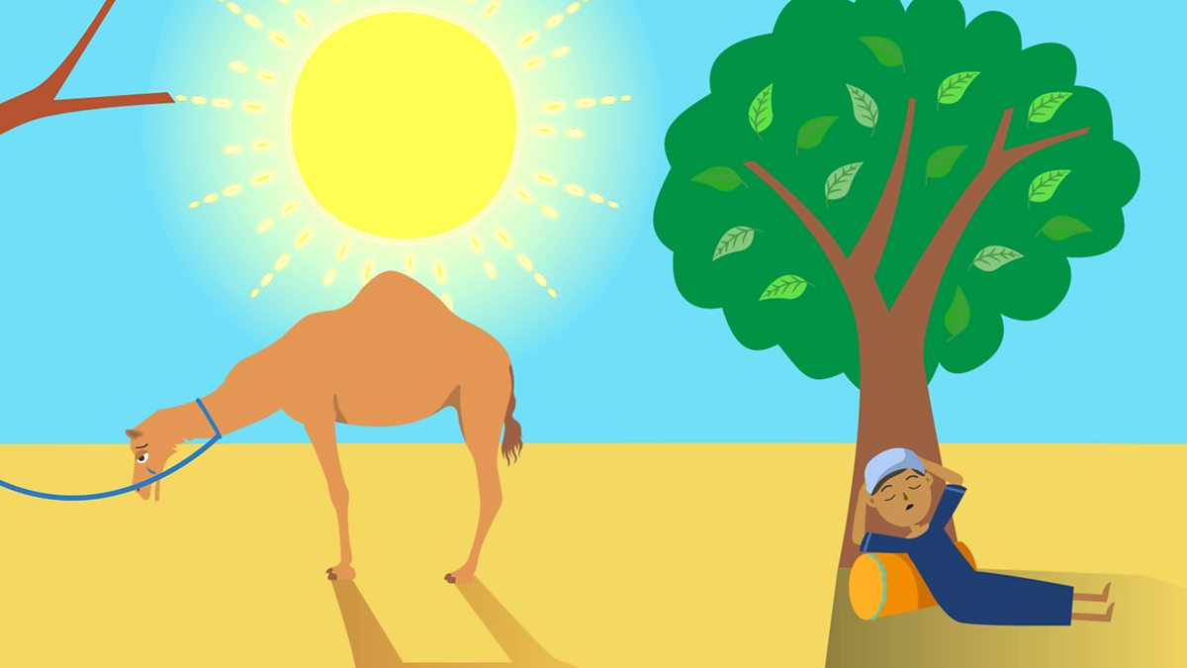
RE
In RE, we will be learning about Islam with a focus on story telling. Many stories have morals to them that encourage us to consider our thoughts and actions. We will read the stories ‘The Prophet and the Ants’ and ‘The Crying Camel’, both of which tell of the importance of insects and animals and the need to care for them. As part of this, we will explore ways that we can look after these creatures including making bird seed balls and gathering materials to create a bug hotel!
PSHE
In PSHE, we will be learning about different ways we can look after our environment.
As part of this we will explore…
Why we shouldn’t litter
What happens to the rubbish we recycle
How we can turn food waste into something useful

Slide 7
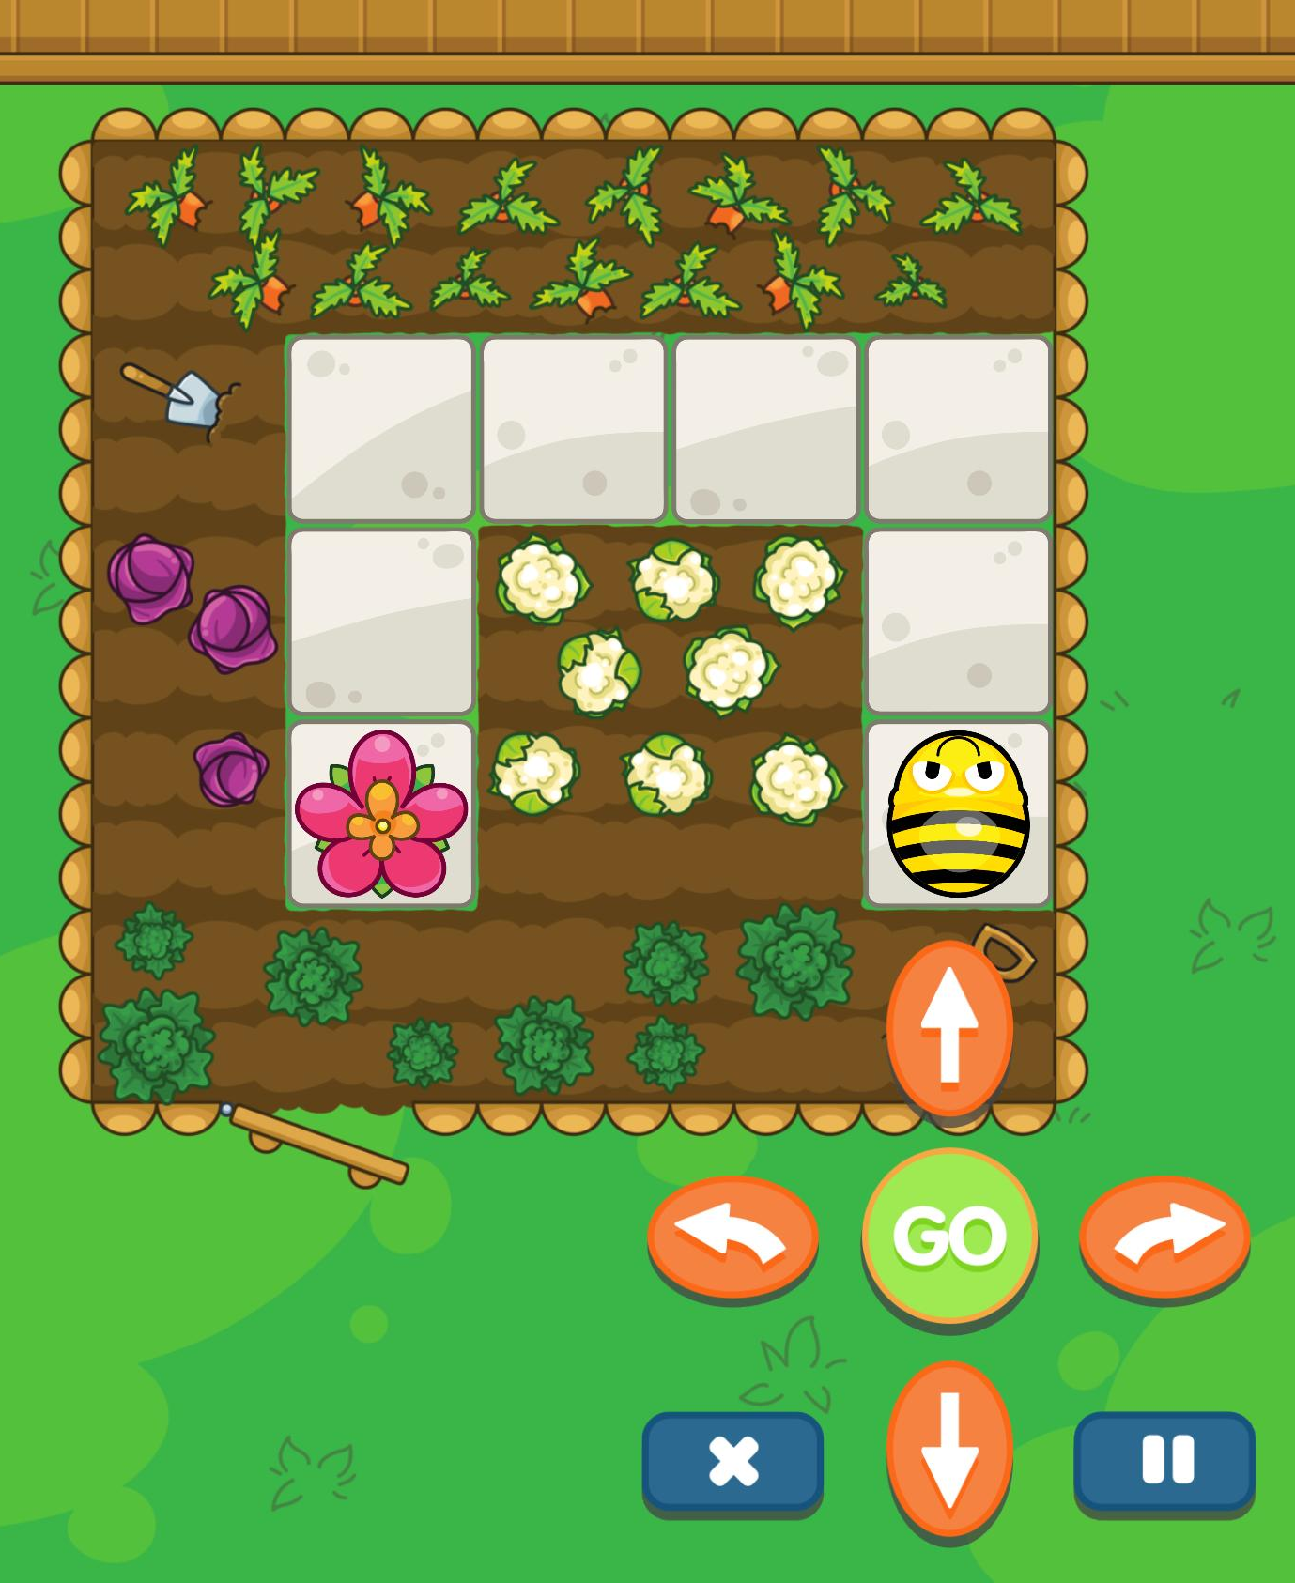

PE and Physio
Children with physio programmes will be continuing to work on this 3 times a week. They have been doing a super job on these!
In PE this half term, we will be doing dance. For this, we will be focusing on imitating and creating movements to sequence together. We will also work on developing our spatial awareness when moving around the space as well as having a go at changing direction.
We will be using pieces of music along with our movements to participate in a group dance to tell an unlikely tale about a penguin and a polar bear becoming friends!
Computing
We will be continue our work on recognising, responding to and using directional language (verbally and/or through use of gesture/symbols) including left, right, forward, backward, up and down. We will have a go at using these directions to guide ourselves to the library before having a go at guiding a peer. Children will then have a go at putting together two instructions to control programmable device.

Slide 8
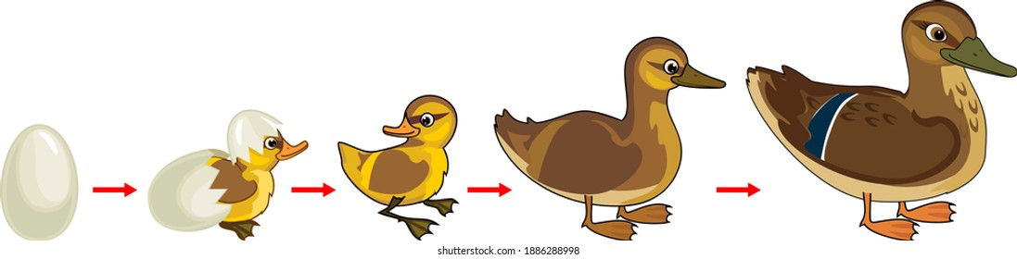
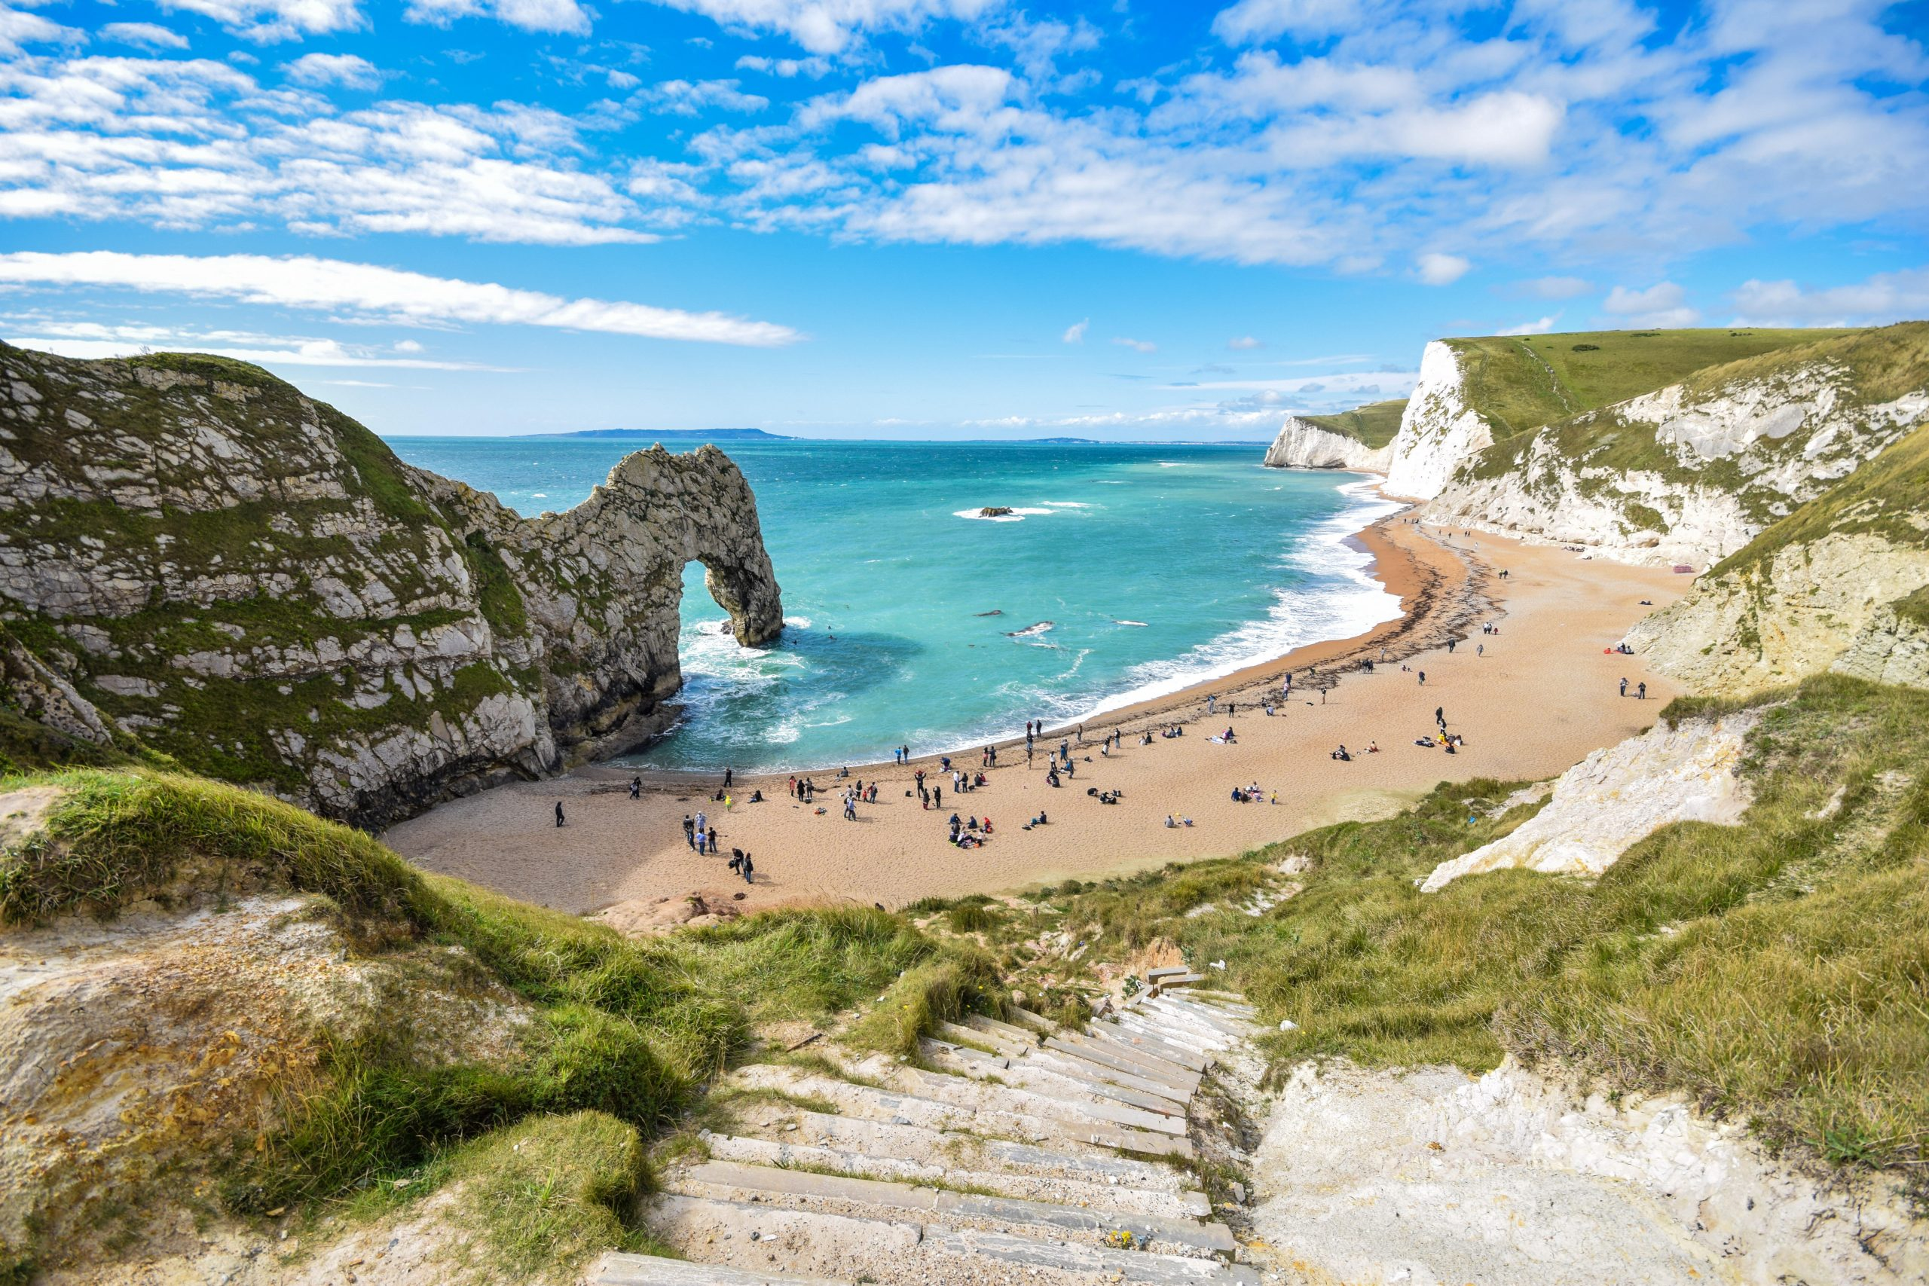
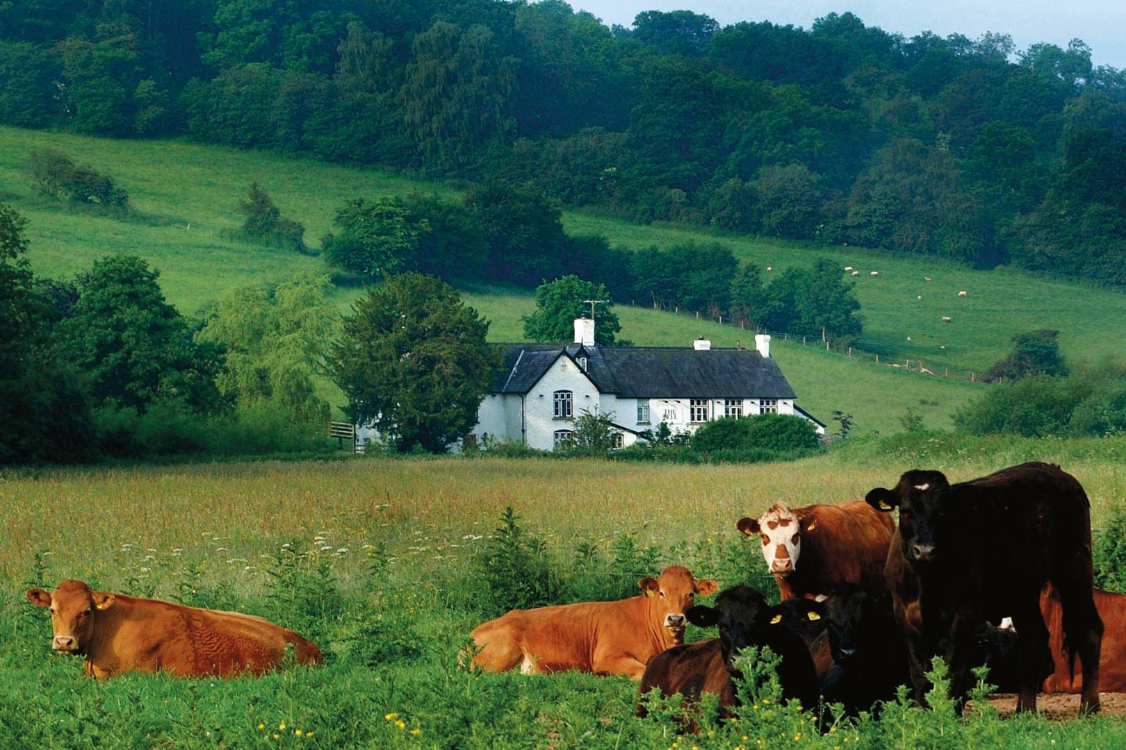
Geography
In Geography, we will be exploring features of our local environment such as houses, schools and roads. We will then consider how our environment varies from others such as beaches and farms.
Science
In science, we will explore how like us humans, animals and insects also experience changes as part of their life cycles. We will firstly explore how we start as babies, then children before becoming teenagers and eventually adults. After, we will explore the life cycle of a duck from egg to adult.

