Slide 1
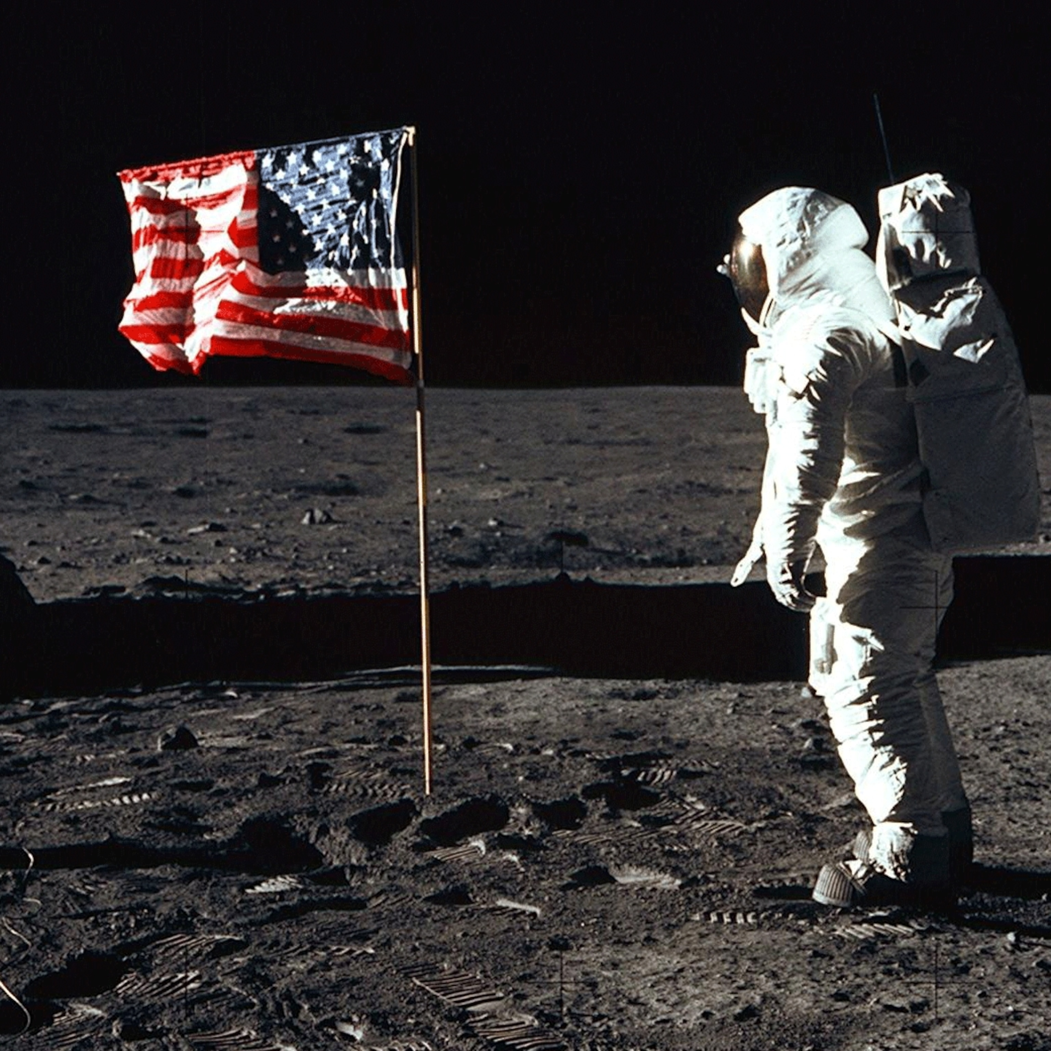
Space and the moon landing
Autumn Term 2

Slide 2

Literacy
Earlier this week, we were shocked to find that a UFO had landed in our classroom – it made quite a mess!
We discovered during our investigation that aliens must have been in the UFO but they were nowhere to be seen.
Over the next few weeks we will be working on identifying aliens from their descriptions to help them get back to their UFO to go back home.
Children will also choose an alien from our book ‘You Choose In Space’ to describe. We will think about what the alien looks like, feels like, smells like, sounds like and what their personality is like.

Slide 3
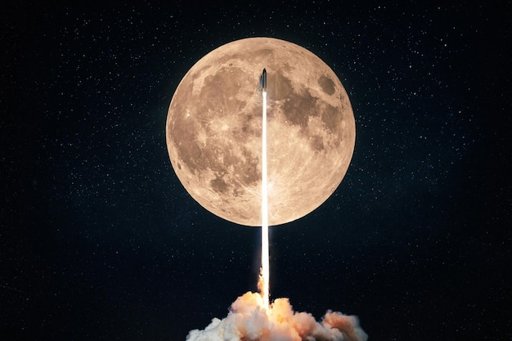

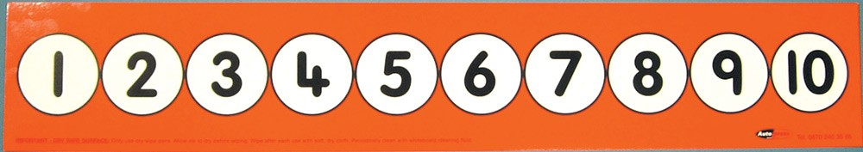
Maths
In Maths, we will be continuing with our theme of space!
We will first prepare the astronauts for their mission by:
Counting out a given amount of objects (some children will be counting an amount of objects on from a given number)
Then, it is time to prepare for take off by:
Ordering numbers forwards and backwards
Counting backwards (either from 5, 10, 20 or higher)
After, we will be helping the astronauts fix their rocket in space by:
Recognising and sorting basic shapes
Counting the sides of shapes
Comparing how many sides a selection shapes have
Finding shapes that have 1 more/1 less side than another shape (some children will be finding 2 more/2 less, 3 more/3 less or more!)
Finally, before they come back to Earth, we will help the astronauts collect moon rocks by:
Identifying missing numbers
Some children may also go onto subitising

Slide 4
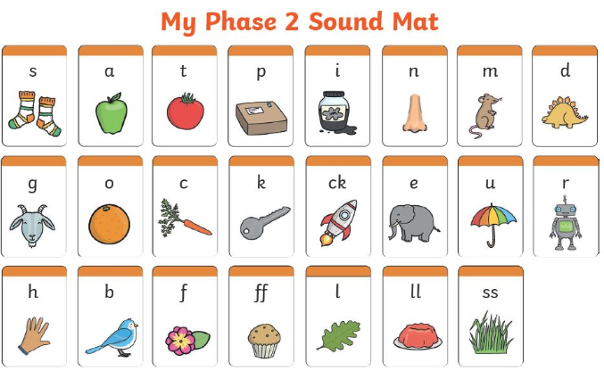
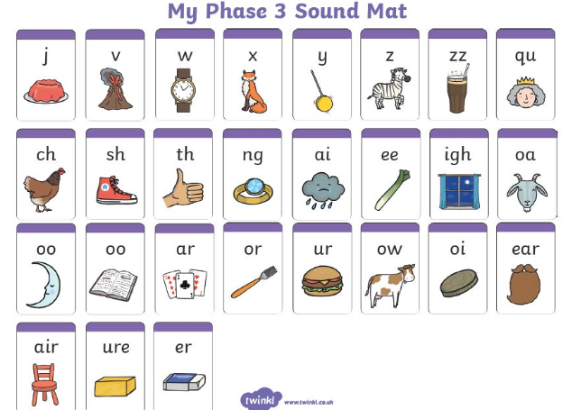
Phonics
Children work in small groups or 1:1 with an adult in phonics 4 times a week.
Over the next few weeks children will be working on building their recognition of different letter sounds, practising blending to read and segmenting to spell words containing sounds they are familiar with. Each group will be working on a different sound according to where they are working at. Some children will be working on Phase 2 sounds whilst others will be working on Phase 3 sounds.
Reading
Children also read 4 times a week in a small group or 1:1 with an adult. Some children will be working on reading decodable books whilst others will be listening to an adult reading to them. Through activities and questioning, children will also work on building comprehension skills.

Slide 5

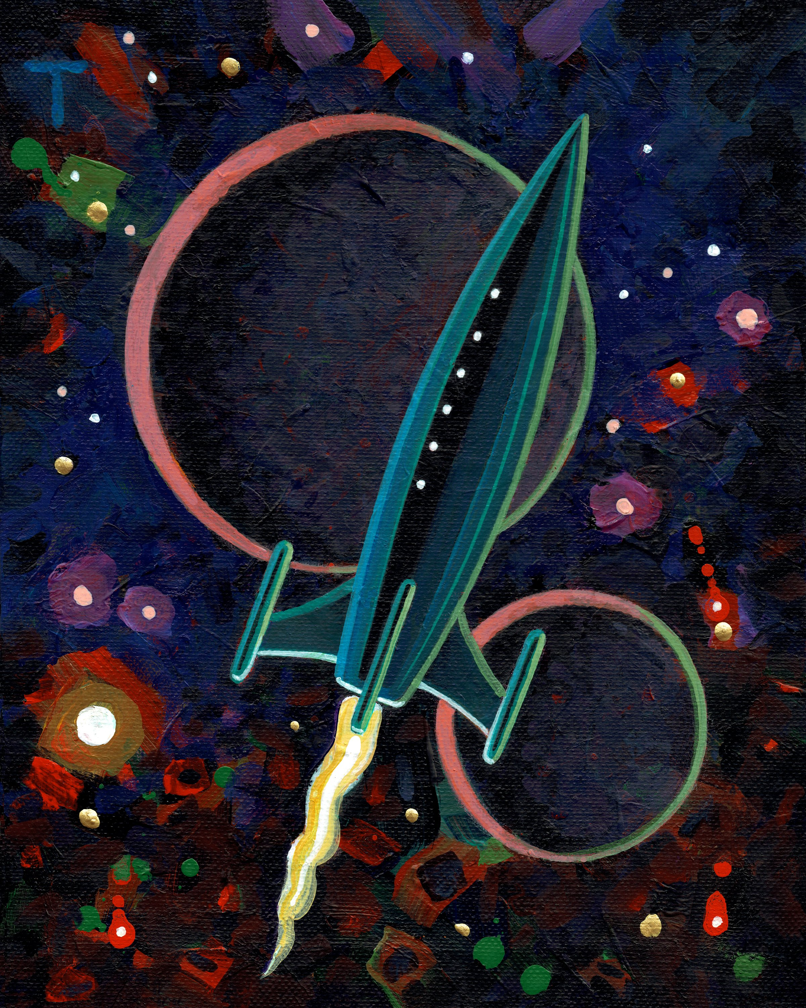
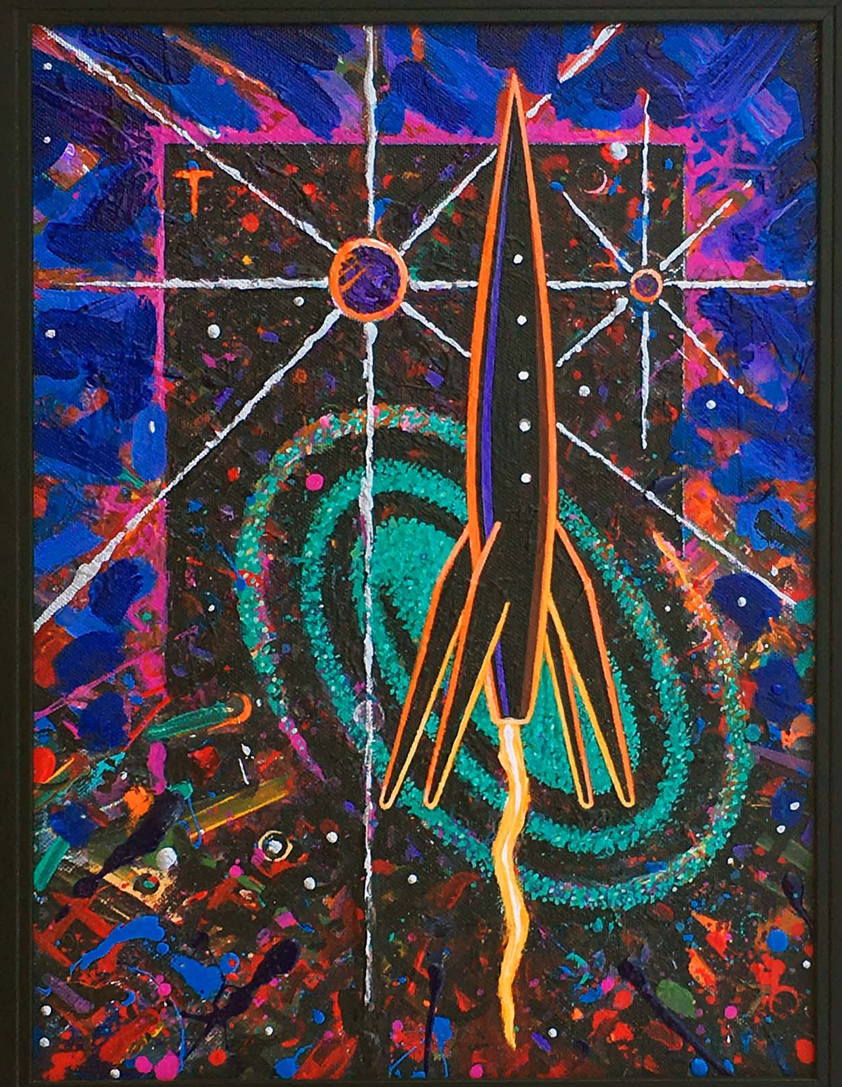
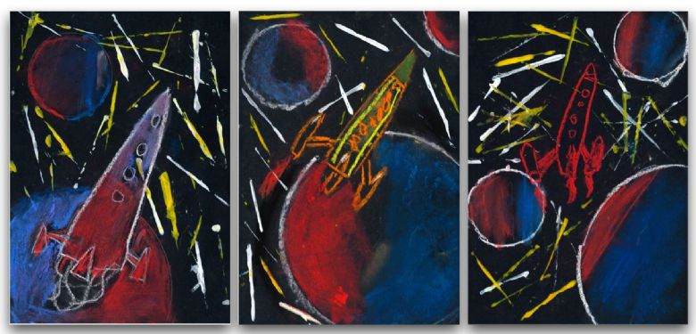
Art
In Art we will be using the work of artist Peter Thorpe as inspiration to create our own images of space and rockets. We will use different mediums such as paint and colour pastels. We will also explore different techniques such as blending, using stencils and splatter painting.

Slide 6

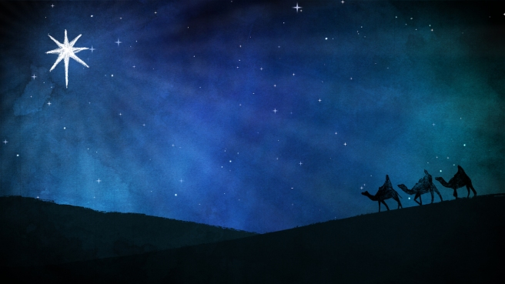
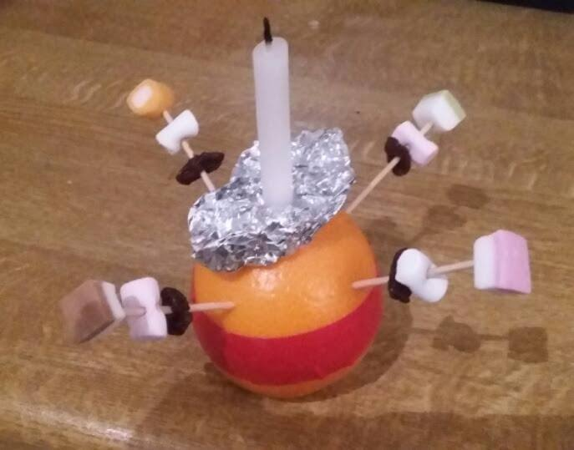
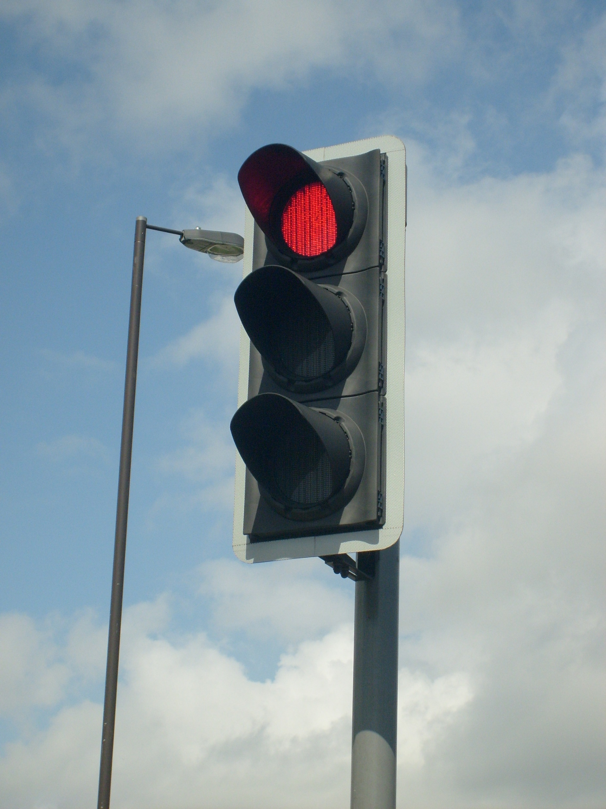

RE
In RE we will be exploring light as a symbol in Christianity. First, we will explore the different sources of light that we are familiar with, including stars!
Then we will explore the ‘Christmas Story’ and how a light guided the Wise Men to Jesus in the stable.
We will also make a ‘Christingle’ and consider what the candle represents for many Christians.
PSHE
In PSHE we will be exploring different situations and the rules that relate to them such as when crossing a road or going to see fireworks. We will also consider why these rules are important.

Slide 7

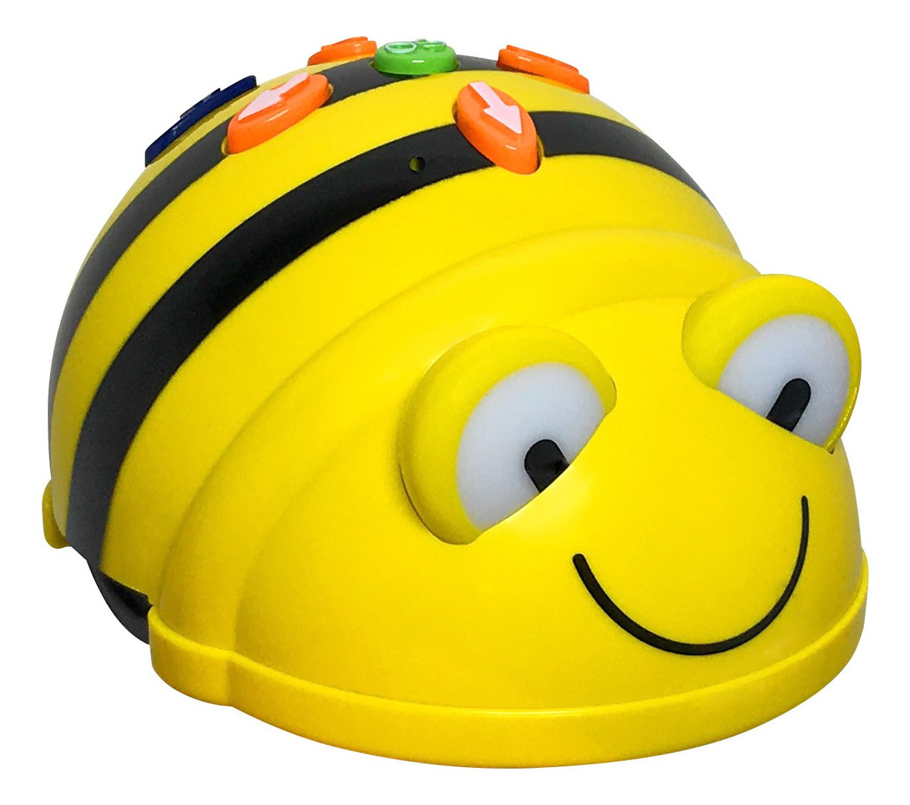
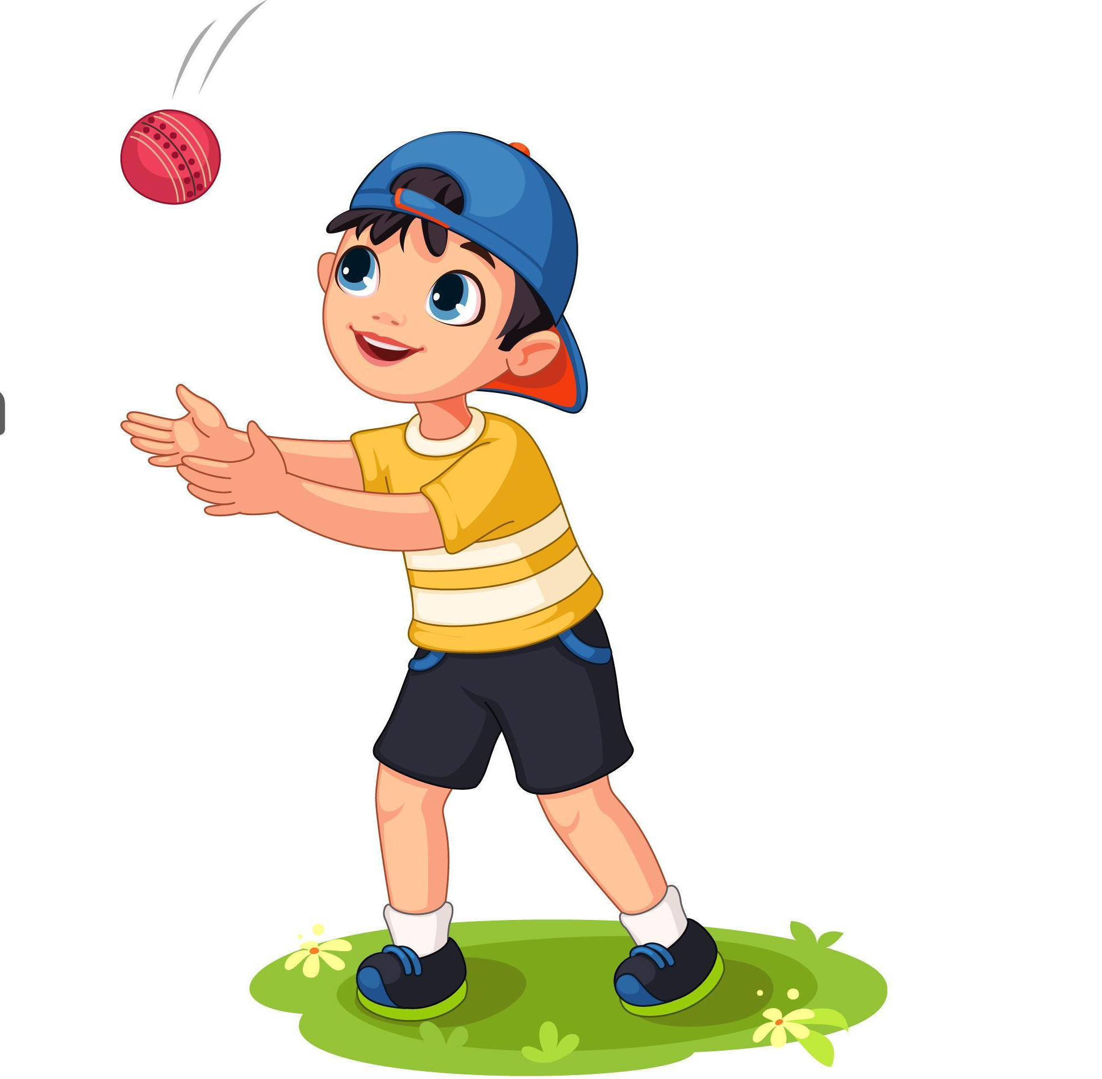
PE and Physio
Children with physio programmes will be continuing to work on this 3 times a week. They have been doing a super job on these!
During the last half term in PE, we were developing our throwing skills by practising using the underarm and overarm throw. This half term we will be developing our catching skills with the aim of using these two skills together to engage in throwing and catching games.
Computing
In Computing, we will be working on developing skills to be able to programme commands on a Bee-Bot. To do this, we will be working on recognising, responding to and using directional language (verbally and/or through use of gesture/symbols) including left, right, forward, backward, up and down.

Slide 8
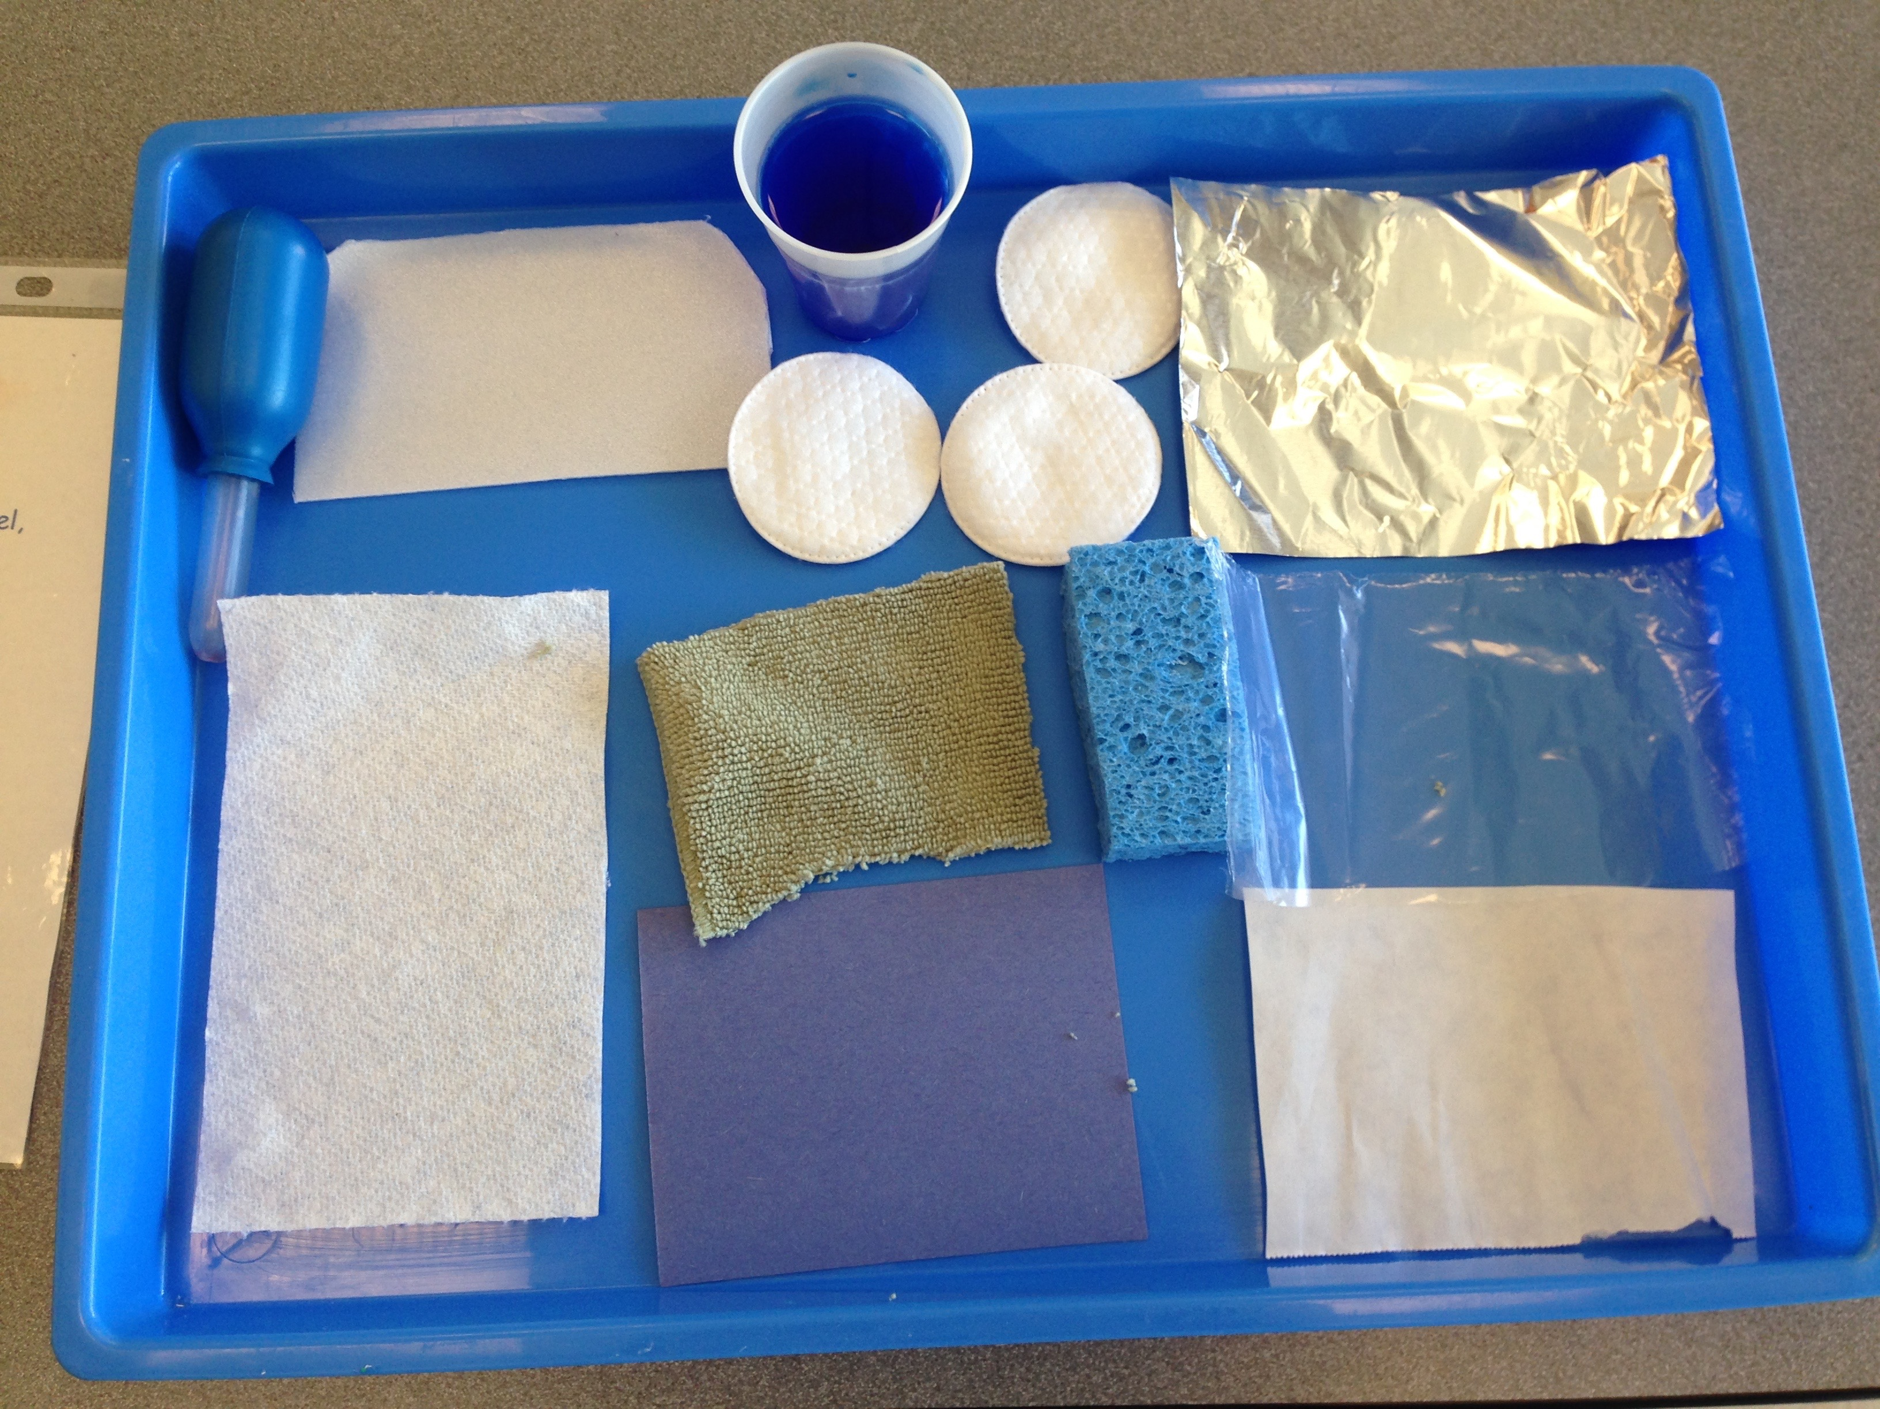
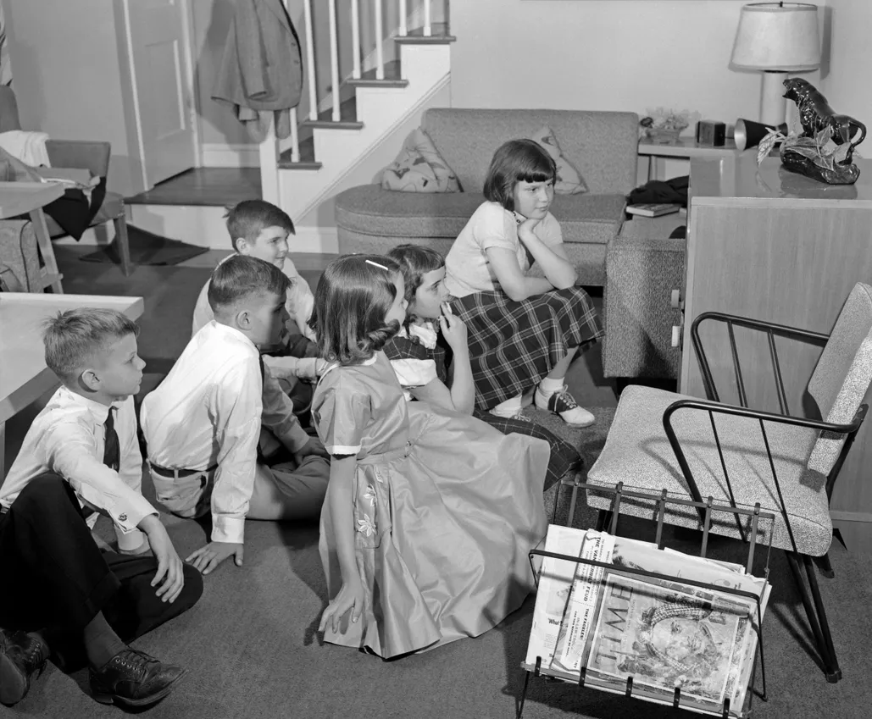
History
In History, we will consider how we feel when something exciting in our lives happen such as a birthday or achieving something new. We will then learn about the first moon landing and consider how people felt when this happened.
Science
In Science, we will be exploring everyday materials and their properties. As part of this, we will investigate what it means if a material is absorbent as well as finding out which materials are absorbent and which are not.

